Slide 1
The Machine Learning Project Lifecycle

Slide 2
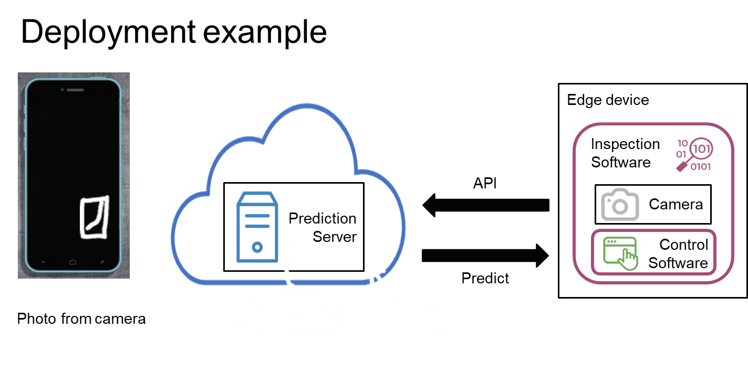

Slide 3
The requirements surrounding ML infrastructure
Data Verification |  | Machine Resource Management | Serving Infrastructure | Monitoring
 | Analysis Tools
 | Process Management Tools
Data Collection
Configuration
ML
Code
Feature Extraction
[D. Sculley et. al. NIPS 2015: Hidden Technical Debt in Machine Learning Systems]

Slide 4
The Machine Learning Project Lifecycle
Steps of an ML project

Slide 5

The ML project lifecycle
Scoping
Data
Modeling
Deployment
Define data and establish baseline
Label and organize data
Select and train model
Perform error analysis
Deploy in production
Monitor & maintain system
Define project

Slide 6
The Machine Learning Project Lifecycle
Case study: speech recognition

Slide 7

Speech recognition: Scoping stage
Scoping
Data
Modeling
Deployment
Define data and establish baseline
Label and organize data
Select and train model
Perform error analysis
Deploy in production
Monitor & maintain system
Define project
Decide to work on speech recognition for voice search.
Decide on key metrics:
Accuracy, latency, throughput
Estimate resources and timeline

Slide 8

Speech recognition: Data stage
Scoping
Data
Modeling
Deployment
Define data and establish baseline
Label and organize data
Select and train model
Perform error analysis
Deploy in production
Monitor & maintain system
Define project
Define data
Is the data labeled consistently?
How much silence before/after each clip?
How to perform volume normalization?
“Um, today’s weather” “Um… today’s weather” “Today’s weather”

Slide 9

Speech recognition: Modeling stage
Scoping
Data
Modeling
Deployment
Define data and establish baseline
Label and organize data
Select and train model
Perform error analysis
Deploy in production
Monitor & maintain system
Define project
Code (algorithm/model)
Research/Academia
Hyperparameters
ML Model
Product Team
Data

Slide 10



Speech recognition: Deployment stage
Scoping
Data
Modeling
Deployment
Define data and establish baseline
Label and organize data
Select and train model
Perform error analysis
Deploy in production
Monitor & maintain system
Define project
Mobile phone (edge device)
Local Software VAD
module
Frontend code
Speech API
Microphone
Prediction
Server
Transcript
Search Results

Slide 11
Deployment
Key challenges

Slide 12

Concept drift and Data drift
Speech recognition example
Training set:
Purchased data, historical user data with transcripts
Test set:
Data from a few months ago
How has the data changed?

Slide 13
Software engineering issues
Checklist of questions
Realtime or Batch
Cloud vs. Edge/Browser
Compute resources (CPU/GPU/memory)
Latency, throughput (QPS)
Logging
Security and privacy
Prediction Service

Slide 14
First deployment vs. maintenance
Scoping
Data
Modeling
Deployment
Define data and establish baseline
Label and organize data
Select and train model
Perform error analysis
Deploy in production
Monitor & maintain system
Define project

Slide 15
Deployment
Deployment patterns

Slide 16
Common deployment cases
New product/capability
Automate/assist with manual task
Replace previous ML system Key ideas:
Gradual ramp up with monitoring
Rollback

Slide 17
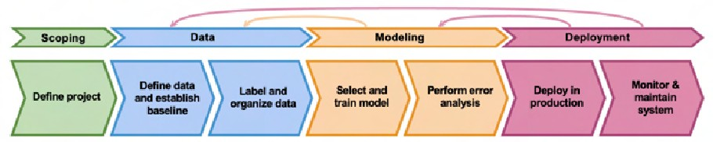





Visual inspection example
Human
Human
Human
ML
ML
ML
ML system shadows the human and runs in parallel.
ML system’s output not used for any decisions during this phase. Sample outputs and verify predictions of ML system.

Slide 18

Canary deployment
Roll out to small fraction (say 5%) of traffic initially.
Monitor system and ramp up traffic gradually.

Slide 19
Blue green deployment
Phone images
Old/Blue version
Router
New/Green version
Easy way to enable rollback

Slide 20







Degrees of automation
Human only
Shadow mode
Partial automation
Full automation
Al assistance
You can choose to stop before getting to full automation.

Slide 21
Deployment
Monitoring

Slide 22
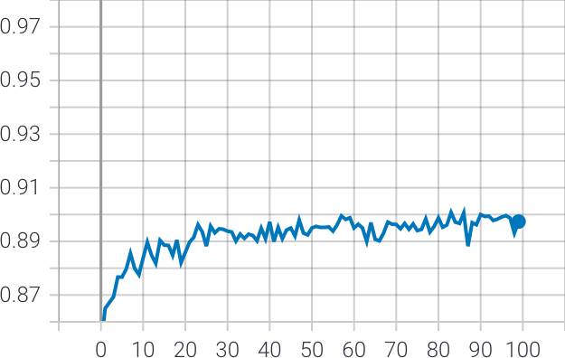
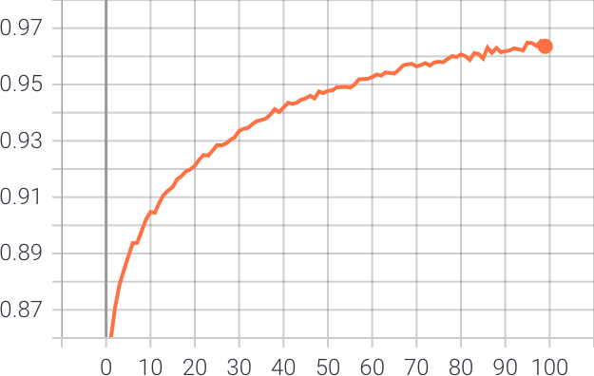
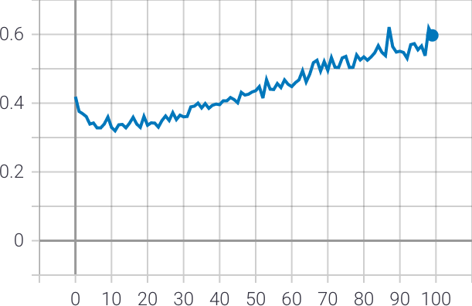
Monitoring dashboard
Server load
Fraction of non-null outputs
Fraction of missing input values
Time Time
Brainstorm the things that could go wrong.
Time
Brainstorm a few statistics/metrics that will detect the problem.
It is ok to use many metrics initially and gradually remove the ones you find not useful.

Slide 23
Examples of metrics to track
Software metrics:
Memory, compute, latency, throughput, server load
Avg input length Avg input volume Num missing values
Avg image brightness
Input metrics:
# times return " " (null)
# times user redoes search
# times user switches to typing CTR
Output metrics:

Slide 24
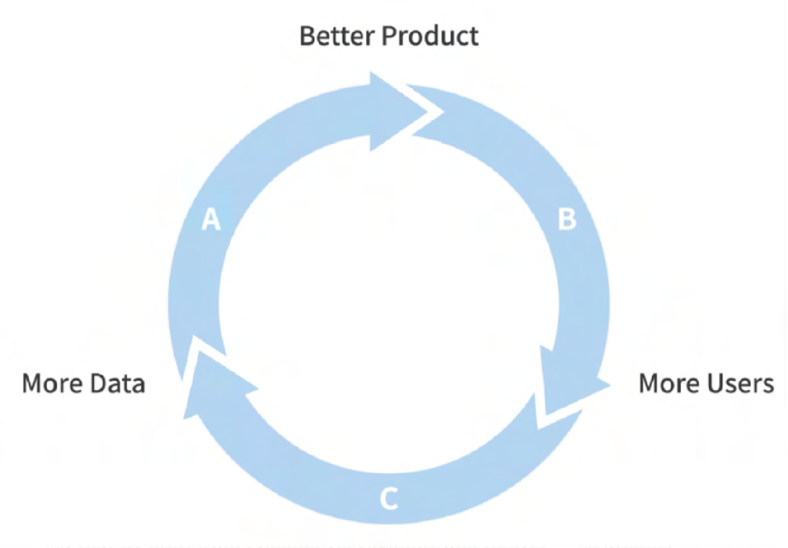
Just as ML modeling is iterative, so is deployment
ML model/data
Deployment/Monitoring
Performance
Error analysis
Experiment
analysis
Traffic
Iterative process to choose the right set of metrics to monitor.

Slide 25
Monitoring dashboard
Server load
Fraction of non-null outputs
Fraction of missing input values
Time
Time
Time
Set thresholds for alarms
Adapt metrics and thresholds over time

Slide 26
Model maintenance
Scoping
Data
Modeling
Deployment
Define data and establish baseline
Label and organize data
Select and train model
Perform error analysis
Deploy in production
Monitor & maintain system
Define project
Manual retraining
Automatic retraining

Slide 27
Deployment
Pipeline monitoring

Slide 28


Speech recognition example
Audio
Transcript
Speech Recognition
Audio
Transcript
VAD
Speech Recognition
Some cellphones might have VAD clip audio differently, leading to degraded performance

Slide 29

User profile example
User Data
User Profile
Recommender system
Product recommendations
(e.g., clickstream)
(e.g., own car?)

Slide 30
Metrics to monitor
Monitor
Software metrics
Input metrics
Output metrics
How quickly do they change?
User data generally has slower drift.
Enterprise data (B2B applications) can shift fast.

Slide 31
MLOps
What it is, Why it Matters, and How to Implement it

Slide 32
What is MLOps?
MLOps is a set of practices for collaboration and communication between data scientists and operations professionals.
Applying these practices increases the quality, simplifies the management process, and automates the deployment of Machine Learning and Deep Learning models in large-scale production environments.
It’s easier to align models with business needs, as well as regulatory requirements.

Slide 33
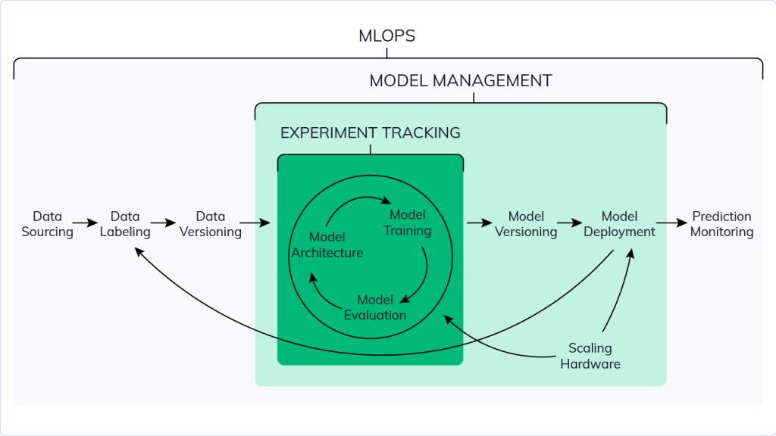
The key phases of MLOps are:
Data gathering
Data analysis
Data transformation/preparation
Model training & development
Model validation
Model serving
Model monitoring
Model re-training.

Slide 34
DevOps and MLOps Similarity
Unlike DevOps, MLOps is much more experimental in nature.
Hybrid team composition
Testing
Automated Deployment
Production performance degradation of the system due to evolving data profiles or simply Training-Serving Skew
Monitoring
Continuous Integration (CI) is no longer only about testing and validating code and components, but also testing and validating data, data schemas, and models.
Continuous Deployment (CD) is no longer about a single software package or service, but a system (an ML training pipeline) that should automatically deploy another service (model prediction service) or roll back changes from a model.
Continuous Testing (CT) is a new property, unique to ML systems, that’s concerned with automatically retraining and serving the models.

Slide 35
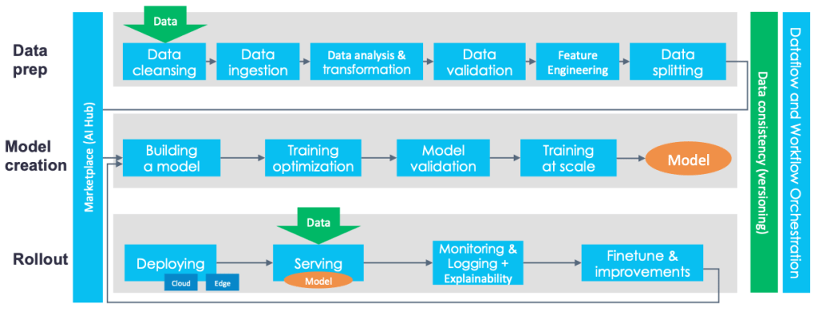
DevOps and MLOps Similarity

Slide 36
MLOps vs Experiment Tracking vs ML Model Management

Slide 37
Introduction to Model Serving
Introduction

Slide 38






What exactly is Serving a Model?
Training a model is only the ﬁrst part
Provide service or app for interaction
Make your model available to end user

Slide 39
Model Serving Patterns
A model,
An interpreter, and
Input data
Inference

Slide 40

Important Metrics
Latency
Metrics to Optimize
Cost
Throughput

Slide 41



Latency
100ms
200ms
Latency = 100 + 200 = 300ms
Delay between user’s action and response of application to user’s action.
Latency of the whole process, starting from sending data to server, performing inference using model and returning response.
Minimal latency is a key requirement to maintain customer satisfaction.

Slide 42
Throughput
➔ Throughput -> Number of successful requests served per unit time say one second.
➔ In some applications only throughput is important and not latency.

Slide 43

Cost
The cost associated with each inference should be minimised.
Important Infrastructure requirements that are expensive:
CPU
Hardware Accelerators like GPU
Caching infrastructure for faster data retrieval.

Slide 44
Minimizing Latency, Maximizing Throughput
Minimizing Latency
Airline Recommendation Service
Reduce latency for user satisfaction
Maximizing Throughput
Airline recommendation service faces high load of inference requests per second.
Scale infrastructure (number of servers, caching requirements etc.) to meet requirements.

Slide 45

Balance Cost, Latency and Throughput
Cost increases as infrastructure is scaled
In applications where latency and throughput can suffer slightly:
Reduce costs by GPU sharing
Multi-model serving etc.,
Optimizing models used for inference

Slide 46
Introduction to Model Serving
Resources and Requirements for Serving Models

Slide 47


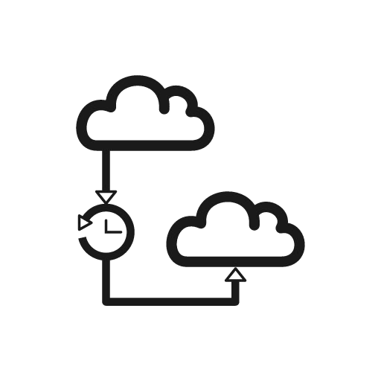

Optimizing Models for Serving
Model Size Complex functions
Prediction Latency Prediction Accuracy
Model Complexity

Slide 48
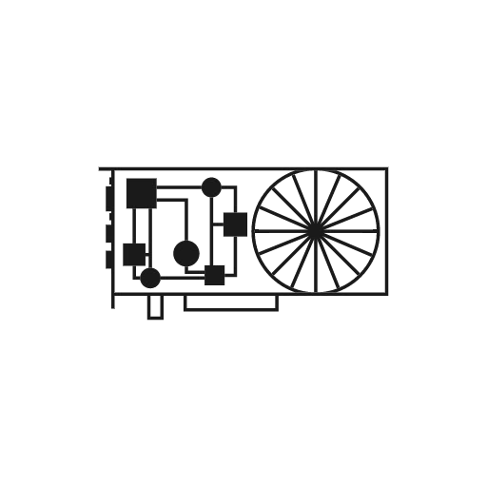



As Model Complexity Increases Cost Increases
GPU TPU
Model registry
Model Complexity
Maintenance burden

Slide 49



Optimizing and Satisﬁcing Metrics
Model’s optimizing metric:
Accuracy
Precision
Recall
Satisﬁcing (Gating) metric:
Latency
Model Size
GPU load

Slide 50



Optimizing and Satisﬁcing Metrics
Specify serving infrastructure
Increase model complexity
Improve predictive power
Hit gating metrics
Accept

Slide 51


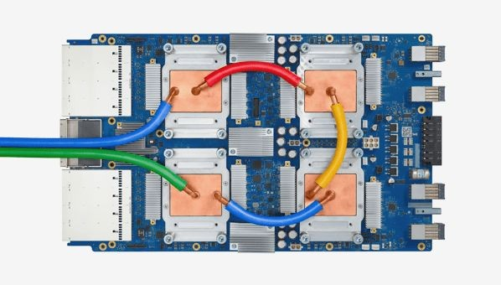
Use of Accelerators in Serving Infrastructure
GPUs for parallel throughput
TPUs for complex models and large batches
Hardware choices impact cost
Balancing complexity and hardware choices
Choices made at organizational level

Slide 52


Model Deployments
Huge data centers
Embedded devices

Slide 53



Prediction Latency is Almost Always Important
Opt for on-device inference whenever possible
Enhances user experience by reducing the response time of your app
Millisecond turnaround
Model efﬁciency
Cost

Slide 54



Other Strategies
Proﬁle and
Optimize Operators
Optimize Model
Tweak Threads
Benchmark

Slide 55





Web Applications for Users
Python:
FastAPI
Flask
Django
Java:
Spring
Apache Tomcat
Users make requests via web application
Model wrapped as API service

Slide 56




Serving systems for easy deployment
Centralized model deployment
Predictions as service
Eliminates need for custom web applications
Deployment just a few lines of code away
Easy to rollback/update models on the ﬂy

Slide 57


Clipper
Open-source project from UC Berkeley
Multiple modeling frameworks
Cluster and resources management
Settings for reliable latency
RESTful API

Slide 58



TensorFlow Serving
Open-source project from Google
Serve TensorFlow models easily
Extensible to serve other model types
Uses REST and gRPC protocol
Version manager

Slide 59

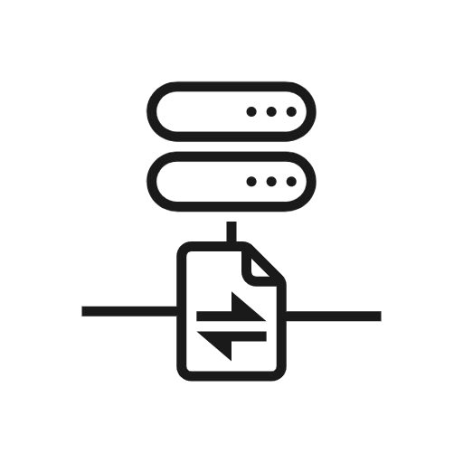

Advantages of Serving with a Managed Service
Realtime endpoint for low-latency predictions on massive batches
Deployment of models trained on premises or on the Google Cloud Platform /AWS
Scale automatically based on trafﬁc
Use GPU/TPU for faster predictions

Slide 60
Model Serving Architecture
Model Serving: Patterns and Infrastructure

Slide 61
ML Infrastructure
Train and deploy on your own hardware infrastructure
Manually procure hardware GPUs, CPUs etc
Proﬁtable for large companies running ML projects for longer time
On Prem
On Cloud
Train and deploy on cloud choosing from several service providers
Amazon Web Services, Google Cloud Platform, Microsoft Azure, etc

Slide 62

Model Servers
Simplify the task of deploying machine learning models at scale.
Can handle scaling, performance, some model lifecycle management etc.,
What’s in this image?
Model File
Model Server
REST / gRPC
Dog 0.99

Slide 63




Model Servers
TensorFlow Serving
TorchServe
KF Serving

Slide 64
TensorFlow Serving
Supports many servables
Feature Transformations
TF Models
Non TF Models
Word Embeddings
Vocabularies
Out of the box integration with TensorFlow Models
Batch and Real-time Multi-Model Serving Inference
Exposes gRPC and REST endpoints

Slide 65
TensorFlow Serving Architecture
CORE
DynamicManager
ASPIRED
TF
Servable
CLIENT
ServableHandle
Loader
VERSIONS
VersionPolicy
Legend:
Source
FILE SYSTEM
Blue: Caller-speciﬁc code
Green: TF Serving core classes / APIs Yellow: Pluggable implementations

Slide 66
NVIDIA Triton Inference Server
Simpliﬁes deployment of AI models at scale in production.
Open source inference serving software
Deploy trained models from any framework:
TensorFlow, TensorRT, PyTorch, ONNX Runtime, or a custom framework
Models can be stored on:
Local storage, AWS S3, GCP, Any CPU-GPU Architecture (cloud, data centre or edge)
HTTP REST or gRPC endpoints are supported.

Slide 67


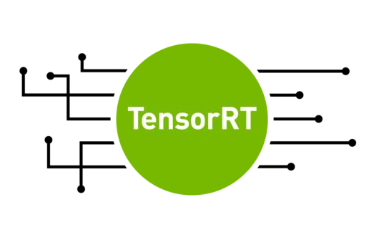



Architecture
Client Application
Python/C++ Client Library
HTTP
gRPC
Model Repository
Triton Inference Server Architecture supports:
Single GPU for multiple models from same or different frameworks
Multi-GPU for same model
Can run instances of model on multiple GPUs for increased inference performance.
Supports model ensembles.
Client app can directly link to C API
Model Management
C API
Inference Request
Inference Response
Pre model
scheduler queues
Framework Backends
Scheduler
Custom
Status health report export
HTTP
GPU GPU GPU GPU CPU

Slide 68



Designed for Scalability
Data Center | Cloud | Edge
AI Inference Cluster
CPU | GPU
Front End Client Applications
Load balancer (optional)
Triton Inference Server
Triton Inference Server
Front End Client Applications
Triton Inference Server
Triton Inference Server
AI Model Repository
Can integrate with KubeFlow pipelines for end to end AI workﬂow

Slide 69
Torch Serve
Model serving framework for PyTorch models.
Initiative from AWS and Facebook
TorchServe
Default handlers for Image Classiﬁcation, Object Detection, Image Segmentation, Text Classiﬁcation
Batch and Real-time Inference
Supports REST Endpoints
Multi-Model Serving
Monitor Detail Logs and Customized Metrics
A/B Testing

Slide 70
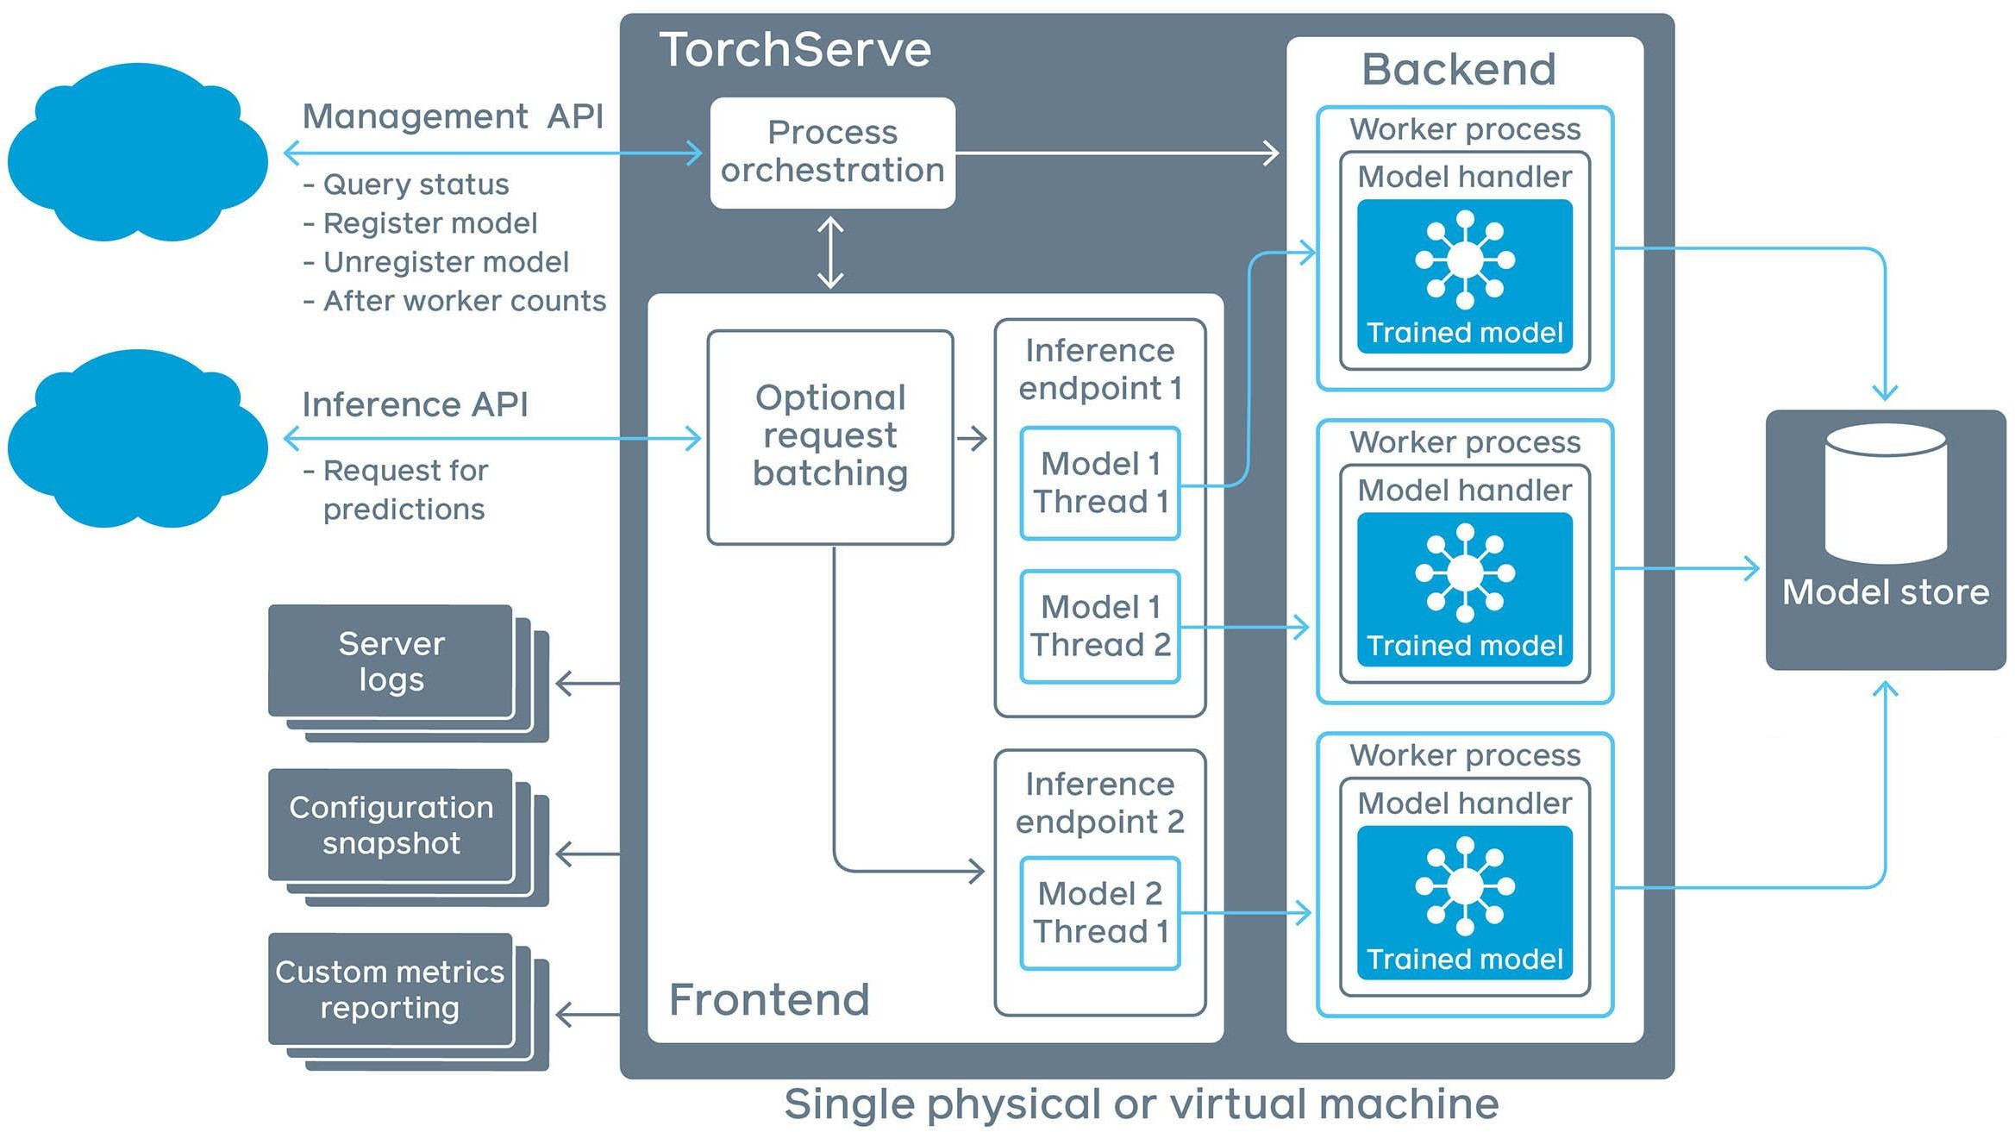
TorchServe Architecture

Slide 71






KFServing
KF Serving
Enables serverless inferencing on Kubernetes.
Provides high abstraction interfaces for common ML frameworks like TensorFlow, PyTorch, scikit-learn etc.
pre-process
predict
post-process
explain
KFServing
Knative
Istio
Kubernetes
Compute Cluster, CPU GPU, TPU

Slide 72

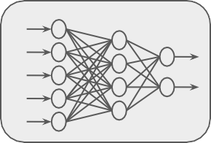
Why is Scaling Important?
Server

Slide 73
+ Increased Power
+ Upgrading
+ More RAM
+ Faster Storage
+ Adding or upgrading GPU/TPU

Slide 74

+ More CPUs/GPUs instead of bigger ones
+ Scale up as needed
+ Scale back down to minimums

Slide 75
Why Horizontal Over Vertical Scaling
Shrink or grow no of nodes based on load, throughput, latency requirements.
No need for taking existing servers ofﬂine for scaling
Beneﬁt of elasticity
Application never goes ofﬂine
Add more nodes any time at increased cost
No limit on hardware capacity

Slide 76
VM Limitations
 | App | App | App | App | App | App
 | Bin/ Library Operating System |  |  | Bin/ Library Operating System
 | Virtual Machine |  |  | Virtual Machine
App
App
App
Bin/ Library
Hypervisor
Operating System
Operating System
Hardware
Hardware

Slide 77
Containers Advantages
Container Container Container
App
App
App
App
App
App
App
App
App
Bin/ Library
Bin/ Library
Operating System
Operating System
Bin/Library
Bin/Library
Bin/Library
Virtual Machine Virtual Machine
Hypervisor
Container Runtime
Operating System
Operating System
Hardware
Hardware

Slide 78
Containers Advantages
Container
Container
Container
Less OS requirements - more apps!
Abstraction
Easy deployment based on container runtime
App
App
App
Bin/Library
Bin/Library
Bin/Library
Container Runtime
Operating System
Hardware

Slide 79
Docker: Container Runtime
Container
Container
Container
App
App
App
Open source container technology
Most popular container runtime
Started as container technology for Linux
Available for Windows applications as well.
Can be used in data centres, personal machines or public cloud.
Docker partners with major cloud services for containerization.
Bin/Library
Bin/Library
Bin/Library
Docker
Operating System
Hardware

Slide 80
Popular Container Orchestration Tools
Kubernetes
Docker Swarm

Slide 81
ML Workﬂows on Kubernetes - KubeFlow
Dedicated to making deployments of machine learning (ML) workﬂows on Kubernetes simple, portable and scalable.
Anywhere you are running Kubernetes, you should be able to run Kubeﬂow.
Can be run on premise or on Kubernetes engine on cloud offerings AWS, GCP, Azure etc.,

Slide 82
Data Preprocessing

Slide 83
Data Preprocessing and Inference
Observation
REST API
Model
Prediction

Slide 84
Preprocessing Operations Needed Before Inference
Data Cleansing
Feature Tuning
Feature Construction
Normalization
Clipping outliers
Imputing Missing Values
Combine inputs
Feature crossing
Polynomial expansion
Correcting invalid values in incoming data
Representation Transformation
Feature Selection
Change data format for the model
One-hot encoding
Vectorization
Apply same feature selection done during training on incoming data and features fetched from cache

Slide 85
Batch Inference
Using ML Models with Distributed Batch and Stream Processing Systems

Slide 86

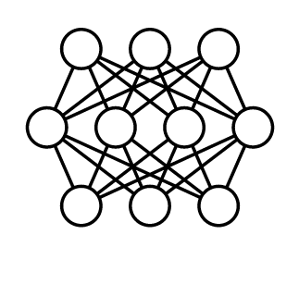


Batch Inference
...
X
X
X
X
Generating predictions on batch of a observations
1
2
3
N
Batch jobs are often generated on some recurring schedule
...
y₁
y₂
y₃
y_{N}
Predictions are stored and made available to developers or end users

Slide 87
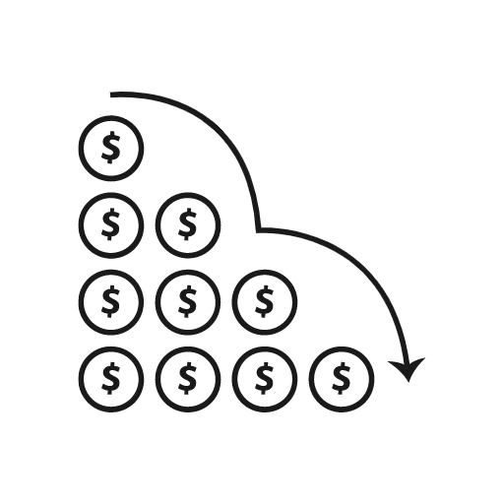



Advantages of Batch Inference
Reduced cost of ML system
X
Caching not required
Complex machine learning models for improved accuracy
Longer data retrieval
Not a problem as predictions are not in real time

Slide 88
Limitations of Batch Inference
Important Metrics to Optimize
Most important metric to optimize while performing batch predictions:
Throughput
Prediction service should be able to handle large volumes of inferences at a time.
Predictions need not be available immediately.
Latency can be compromised.

Slide 89
Data Processing - Batch and Streaming
Data can be of different types based on the source.
Batch Data
Batch processing can be done on data available in huge volumes in data lakes, from csv ﬁles, log ﬁles etc.,
Streaming Data
Real-time streaming data, like data from sensors.

Slide 90
ETL on Data
Before data is used for making batch predictions:
It has to be extracted from multiple sources like log files, streaming sources, APIs, apps etc.,
Transformed
Loaded into a database for prediction
This is done using ETL Pipelines

Slide 91
ETL Pipelines
Transformation Engine
Batch Prediction Job on Prepared Data
Data Sources
Extract
Transform
Load
Target
Set of processes for
extracting data from data sources
Transforming data
Loading into an output destination like data warehouse
From there data can be consumed for training or making predictions using ML models,

Slide 92
Distributed Processing
Worker
Load
Cluster Manager
Worker
Extract
Data Sources
Worker
Target
ETL can be performed huge volumes of data in distributed manner.
Data is split into chunks and parallely processed by multiple workers.
The results of the ETL workﬂow are stored in a database.
Results in lower latency and higher throughput of data processing.

Slide 93



ETL Pipeline components Batch Processing
Transformation Engine
Batch Prediction Job on Prepared Data
Data Sources
Transform
Load
Target
Data Warehouse Eg: BigQuery
Data Mart
Data Lake
Eg: Cloud Storage
CSV Files
XML
JSON
APIs
Data Lake (like cloud storage)
+
Cloud DataFlow

Slide 94
ETL Pipeline components Batch Processing
Transformation Engine
Batch Prediction Job on Prepared Data
Data Sources
Transform
Load
Target
Data Warehouse Eg: BigQuery
Data Mart
Data Lake
Eg: Cloud Storage
CSV Files
XML
JSON
APIs
Data Lake (like cloud storage)
+
Cloud DataFlow

Slide 95
ML Experiments Management and Workﬂow Automation
Tools for Experiment Tracking

Slide 96
What does it mean to track experiments?
Enable you to duplicate a result
Enable you to meaningfully compare experiments
Manage code/data versions, hyperparameters, environment, metrics
Organize them in a meaningful way
Make them available to access and collaborate on within your organization

Slide 97
Data Versioning
Data reﬂects the world, and the world changes
Experimental changes include changes in data
Tracking, understanding, comparing, and duplicating experiments includes data

Slide 98
Tools for Data Versioning
Neptune
Pachyderm
Delta Lake
Git LFS
DoIt
lakeFS
DVC
ML-Metadata

Slide 99
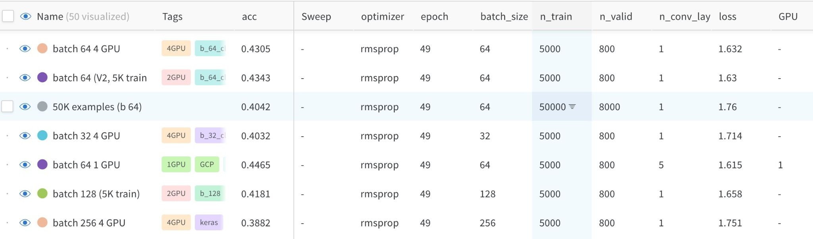
Experiment tracking to compare results

Slide 100

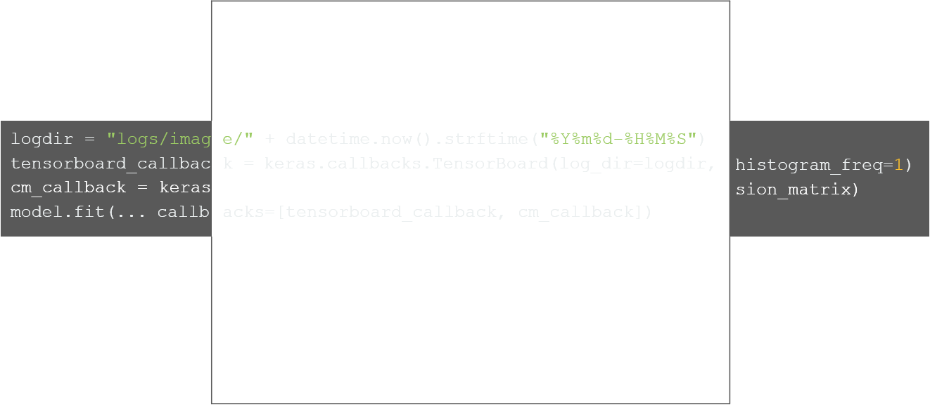
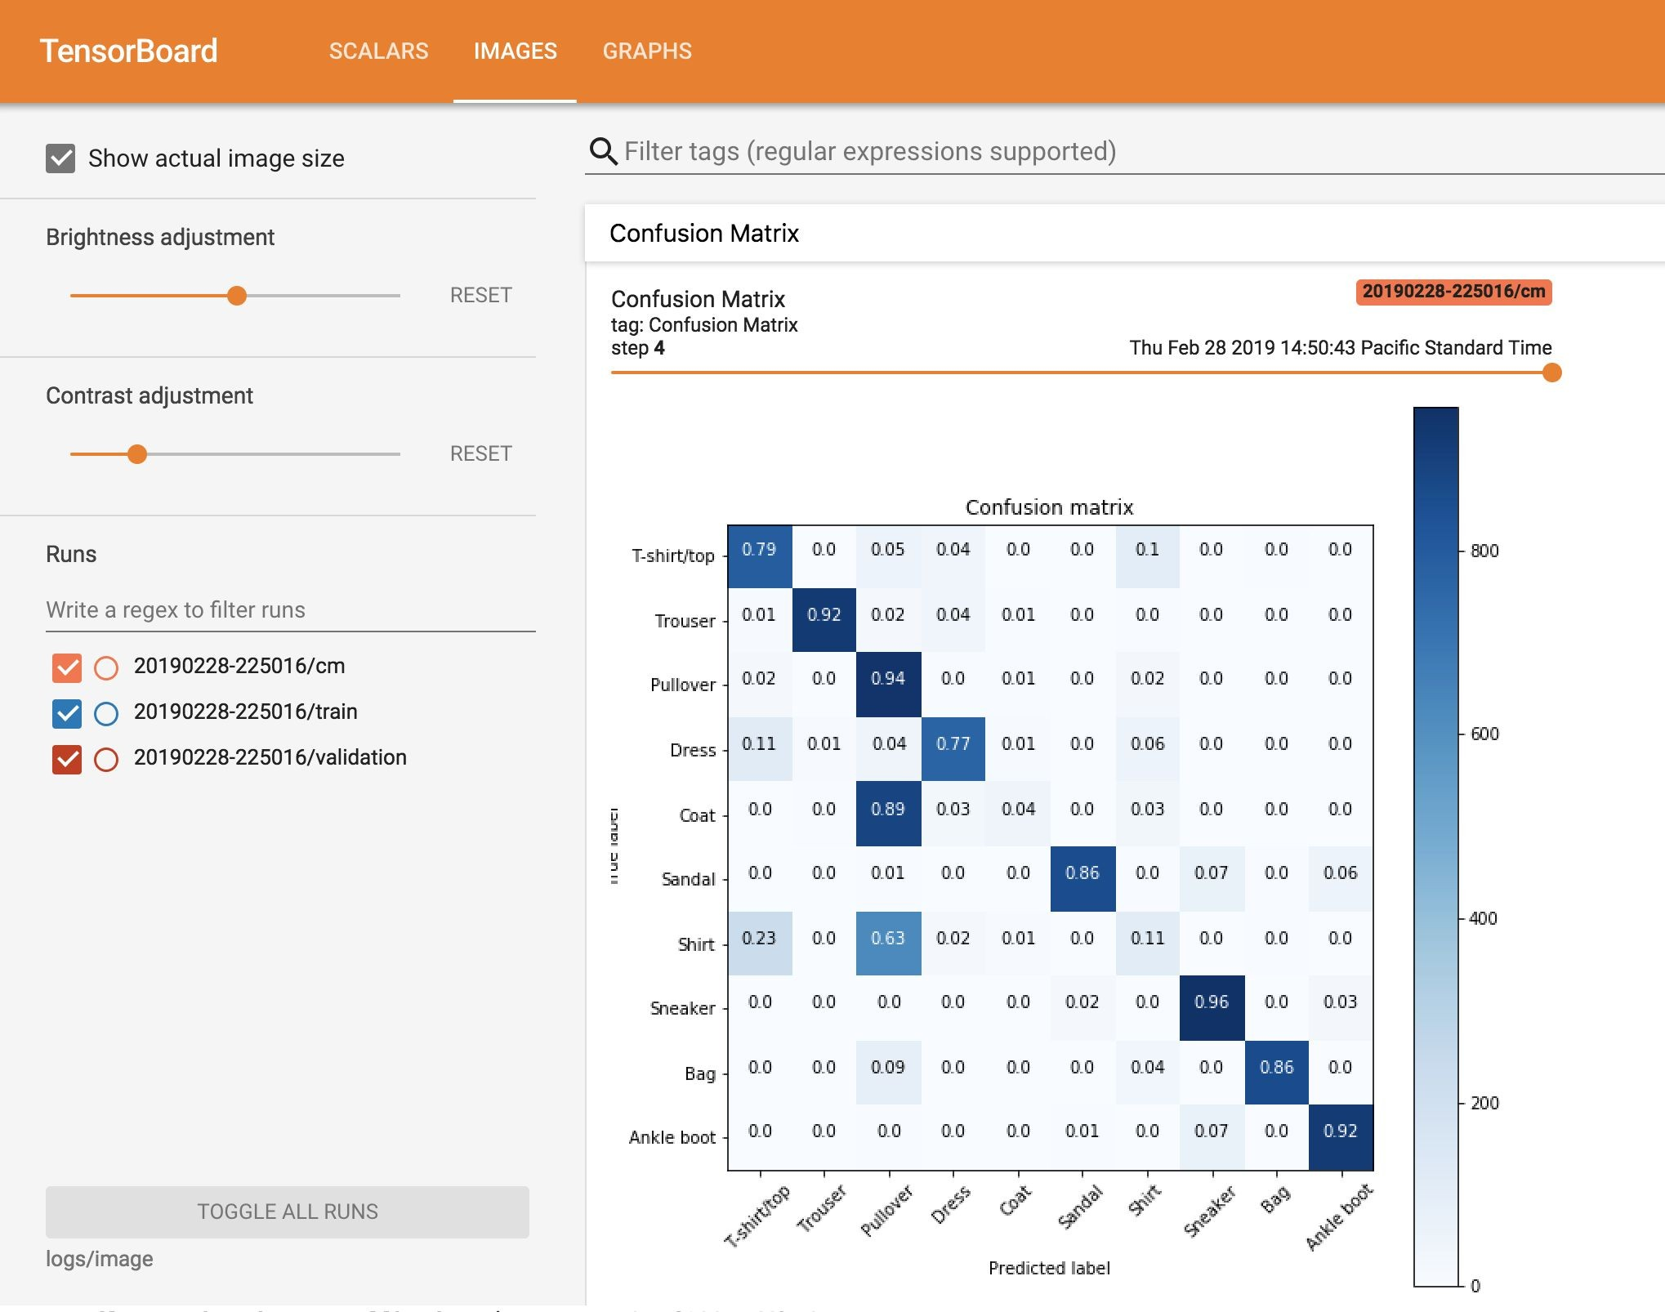
Example: Logging metrics using TensorBoard

Slide 101

Experiments are iterative in nature
Creative iterations for ML experimentation
Deﬁne a baseline approach
Develop, implement, and evaluate to get metrics
Assess the results, and decide on next steps
Latency, cost, fairness, etc.

Slide 102
ML Experiments Management and Workﬂow Automation
Introduction to MLOps

Slide 103
Data Scientists vs. Software Engineers
Data Scientists
Often work on ﬁxed datasets
Focused on model metrics
Prototyping on Jupyter notebooks
Expert in modeling techniques and feature engineering
Model size, cost, latency, and fairness are often ignored

Slide 104
Data Scientists vs. Software Engineers
Software Engineers
Build a product
Concerned about cost, performance, stability, schedule
Identify quality through customer satisfaction
Must scale solution, handle large amounts of data
Detect and handle error conditions, preferably automatically
Consider requirements for security, safety, fairness
Maintain, evolve, and extend the product over long periods

Slide 105
Key problems affecting ML efforts today
We’ve been here before
In the 90s, Software Engineering was siloed
Weak version control, CI/CD didn’t exist
Software was slow to ship; now it ships in minutes
Is that ML today?
Today’s perspective
Models blocked before deployment
Slow to market
Manual tracking
No reproducibility or provenance
Inefﬁcient collaboration
Unmonitored models

Slide 106
Bridging ML and IT with MLOps
Continuous Integration (CI): Testing and validating code, components, data, data schemas, and models
Continuous Delivery (CD): Not only about deploying a single software package or a service, but a system which automatically deploys another service (model prediction service)
Continuous Training (CT): A new process, unique to ML systems, that automatically retrains candidate models for testing and serving
Continuous Monitoring (CM): Catching errors in production systems, and monitoring production inference data and model performance metrics tied to business outcomes

Slide 107
ML Solution Lifecycle
Experimentation/ Development
Continuous Training
Continuous Monitoring
Model Deployment
Data Scientist/ML Engineering
ML Engineering/Data Scientist
ML Engineering/DevOps Engineer
ML Engineering/DevOps Engineer

Slide 108
Standardizing ML processes with MLOps
ML Lifecycle Management
Model Versioning & Iteration
Model Monitoring and Management
Model Governance
Model Security
Model Discovery

Slide 109
MLOps Methodology
MLOps level 0

Slide 110
What deﬁnes an MLOps process’ maturity?
The level of automation of ML pipelines determines the maturity of the MLOps process
As maturity increases, the available velocity for the training and deployment of new models also increases
Goal is to automate training and deployment of ML models into the core software system, and provide monitoring

Slide 111
MLOps level 0: Manual process
Manual, script-driven, interactive
Local data
Manual Experiment Steps
Exploratory
Data Analysis
Data Preparation
Model
Training
Model Evaluation
Model Analysis

Slide 112
MLOps level 0: Manual process
Disconnection between ML and operations
Local data
Data Science
IT
Manual Experiment Steps
Trained Model
Model Deployment
Exploratory
Data Analysis
Data Preparation
Model
Training
Model Evaluation
Model Analysis
Storage

Slide 113
MLOps level 0: Manual process
Less frequent releases, so no CI/CD
Local data
Data Science
IT
Manual Experiment Steps
Trained Model
Model Deployment
Exploratory
Data Analysis
Data Preparation
Model
Training
Model Evaluation
Model Analysis
Storage

Slide 114
How do you scale?
Deployment and lack of active performance monitoring
Local data
Data Science
IT
Manual Experiment Steps
Trained Model
Model Deployment
Exploratory
Data Analysis
Data Preparation
Model
Training
Model Evaluation
Model Analysis
Storage

Slide 115
Challenges for MLOps level 0
Need for actively monitoring the quality of your model in production
Retraining your production models with new data
Continuously experimenting with new implementations to improve the data and model

Slide 116
MLOps Methodology
MLOps levels 1 and 2

Slide 117

MLOps level 1: ML pipeline automation
Rapid experimentation
Orchestrated Experiment
Source code
Development datasets
Data Validation
Data Prep.
Model Training
Model Eval.
Model Valid.
Source Repository
Exploratory Data Analysis

Slide 118
Reusable, composable, and shareable components
Model Analysis
ML Ops
Orchestrated Experiment
Pipeline Deployment
Data Analysis
Sour^{c}ce
Source
Data Validation
Data Prep.
Model Training
Model Eval.
Model Valid.
_{c}S_{o}o_{d}u_{e}rce
repository
code
Ofﬂine extract
experimentation/dev/test
Feature
Store
staging/preprod/prod
Models Registry
Trained
Model
Batch fetching
Automated Pipeline
CD: Model Serving
Trigger
Data
Extraction
Data
Validation
Data Model Prep. Training
Model
Eval.
Model Valid.
Metadata DB
Performance Monitoring
Prediction Service
Real-time feature fetching

Slide 119
Continuous delivery of models
Model Analysis
ML Ops
Orchestrated Experiment
Pipeline Deployment
Data Analysis
Sour^{c}ce
Source
Data Validation
Data Prep.
Model Training
Model Eval.
Model Valid.
_{c}S_{o}o_{d}u_{e}rce
repository
code
Ofﬂine extract
experimentation/dev/test
Feature
Store
staging/preprod/prod
Models Registry
Trained
Model
Batch fetching
Automated Pipeline
CD: Model Serving
Trigger
Data Extraction
Data Validation
Data Prep.
Model Training
Model Eval.
Model Valid.
Metadata DB
Performance Monitoring
Prediction Service
Real-time feature fetching

Slide 120
MLOps level 2: CI/CD pipeline automation
MLOps
Data Analysis
Orchestrated Experiment
CI: Build, test, & package pipeline components
Sour^{c}c
Source
Pa_{P}c_{a}k_{c}a_{k}g_{a}e_{g}s_{es}
_{e}So_{co}u_{d}rc_{e}e
Packages
e_{co}c_{d}o_{e}de
repository
Model Analysis
CD: Pipeline Deployment
experimentation/dev/test
Feature
Store
staging/preprod/prod
Models Registry
Trained
Model
Automated Pipeline
CD: Model Serving
Trigger
Data Extraction
Data
Validation
Data Prep.
Model
Training
Model
Eval.
Model Valid.
Metadata DB
Performance Monitoring
Prediction Service

Slide 121
Experimentation/
Development
Code and
ML
conﬁgurations
Metadata
Code Repository
Training
Pipeline CI/CD
Pipeline artifacts
Artifact Repository
Continuous
Training
Trained
model
Model Deployment CI/CD
Model Registry
Model deployment
Putting all together
Serving and Monitoring
Serving Infrastructure
Serving logs
Logs

Slide 122
MLOps Methodology
Developing components for an orchestrated workﬂow

Slide 123
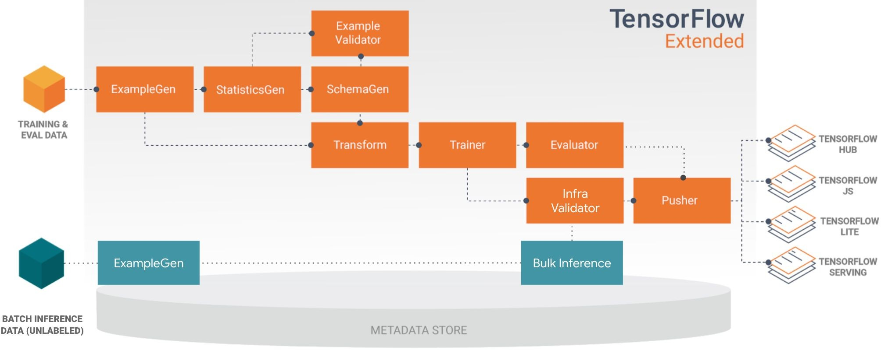
Orchestrate your ML workﬂows with TFX
Pre-built and standard components, and 3 styles of custom components
Components can also be containerized
Examples of things you can do with TFX components:
Data augmentation, upsampling, or downsampling
Anomaly detection based on conﬁdence intervals or autoencoder reproduction error
Interfacing with external systems like help desks for alerting and monitoring
… and more!

Slide 124
Hello TFX

Slide 125
Anatomy of a TFX Component
Component Speciﬁcation
The component's input and output contract Executor Class
Implementation of the component’s processing Component Class
Combines the speciﬁcation with the executor to create a TFX component

Slide 126
Fully custom components
Deﬁne custom component spec, executor class, and component class
Component reusability
Reuse a component spec and implement a new executor that derives from an existing component

Slide 127
Model Management and Deployment Infrastructure
Managing Model Versions

Slide 128










Why versioning ML Models?
Version Control
Team 3
Team 1
Server
Team 2
Code
Data
Model version x
Conﬁg

Slide 129
A Model Versioning Proposal
Version: MAJOR.MINOR.PIPELINE
MAJOR: Incompatibility in data or target variable
MINOR: Model performance is improved
PIPELINE: Pipeline of model training is changed

Slide 130
What is model lineage?
Code
Data
Model version x
Conﬁg
Artifacts: information needed to preprocess data and generate result (code, data, conﬁg, model)
ML orchestration frameworks may store operations and data artifacts to recreate model
Post training artifacts and operations are usually not part of lineage

Slide 131




What is a model registry?
Trained Model
Model Registry
Staging Production Archived
Metadata Artifacts
Model
Parameters
Central repository for storing trained ML models
Provides various operations of ML model development lifecycle
Promotes model discovery, model understanding, and model reuse
Integrated into OSS and commercial ML platforms

Slide 132
Examples of Model Registries
Azure ML Model Registry
SAS Model Manager
MLﬂow Model Registry
Google AI Platform
Algorithmia

Slide 133
Model Management and Deployment Infrastructure
Continuous Delivery

Slide 134
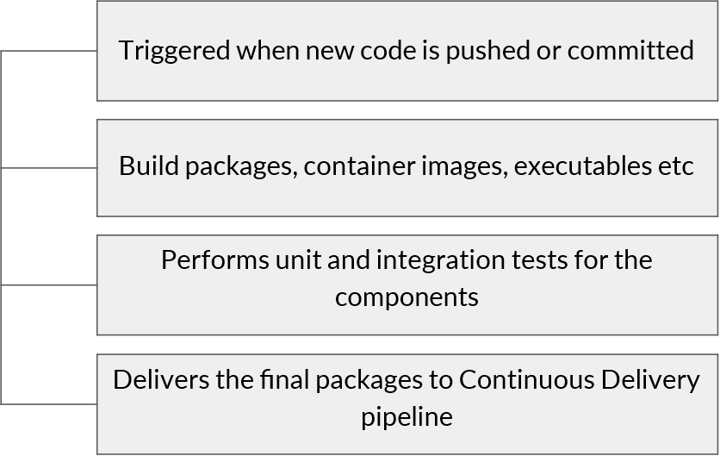
What is Continuous Integration (CI)
Continuous Integration

Slide 135
What is Continuous Delivery (CD)
Deploys new code and trained models to the target environment
Continuous Delivery
Ensures compatibility of code and models with the target environment
Checks the prediction service performance of the model before deploying

Slide 136
CI/CD Infrastructure
Model analysis
Data analysis
Orchestrated experiment
Source code
CI: Build, test, & package pipeline components
Source
Packages
Repository
Feature store
CD: Pipeline Deployment
development/test
staging/pre-production/production
CD: Model serving
Performance monitoring
Prediction service

Slide 137
Unit Testing in CI
Testing that each component in the pipeline produces the expected artifacts.
Unit testing in CI
Unit testing Data
Unit testing Model performance

Slide 138
Unit Testing Input Data
Test feature engineering logic
Test values
Input data
Test format

Slide 139
Unit Testing Model Performance
Test model methods
Test the model performance
metrics
Model
Test to avoid inherent bias
Test to avoid NaN values,
empty strings

Slide 140
Model Management and Deployment Infrastructure
Progressive Delivery

Slide 141
Progressive Delivery
Progressive Delivery is essentially an improvement over Continuous Delivery
Initial Stage
Later Stage
Decrease deployment risk
Faster deployment
Gradual rollout and ownership
Deliver changes ﬁrst to small, low risk audiences
Expand to larger riskier audience

Slide 142
Complex Model Deployment Scenarios
You can deploy multiple models performing same task
Deploying competing models, as in A/B testing
Deploying as shadow models, as in Canary testing

Slide 143




Blue/Green deployment
User Trafﬁc
No downtime
Quick rollback & reliable
Smoke testing in production environment
Load Balancer
Code Version 2 (Green)
The diagrams are illustrations based on:
https://dev.to/mostlyjason/intro-to-deployment-strategies-blue-green-canary-and-more-3a3#
Code Version 1 (Blue)

Slide 144



Canary deployment
User Trafﬁc
Load Balancer
Version 1
Version 2

Slide 145
Canary deployment
User Trafﬁc
Load Balancer
Version 1
Version 2

Slide 146
Canary deployment
User Trafﬁc
Load Balancer
Version 1
Version 2

Slide 147
Live Experimentation
Model metrics are usually not exact matches for business objectives
Example: Recommender systems
Model trained on clicks
Business wants to maximize proﬁt
Example: Different products have different proﬁt margins

Slide 148
Live Experimentation: A/B Testing
Client
Users are divided into two groups
Users are randomly routed to different models in environment
You gather business results from each model to see which one is performing better
Application
Model A
Model B

Slide 149






















Live Experimentation: A/B Testing
A
B
Large use data is fed to the system
The system randomly assigns people into two groups
Relationship between the treatment received and the observed difference are analysed to validate the hypothesis

Slide 150
Model Monitoring
Why Monitoring Matters

Slide 151
ML Lifecycle Revisited
Model building
Model evaluation
Testing
Deployment
Monitoring & Observability
Productionze

Slide 152
Why do you need monitoring?
Immediate Data Skews
Training data is too old, not representative of live data
Model Staleness
Environmental shifts
Consumer behaviour
Adversarial scenarios
Negative Feedback Loops

Slide 153
Monitoring in ML Systems
ML Monitoring (functional monitoring)
Predictive performance Changes in serving data
Metrics used during training Characteristics of features
System monitoring (non-functional monitoring)
System performance System status
System reliability

Slide 154
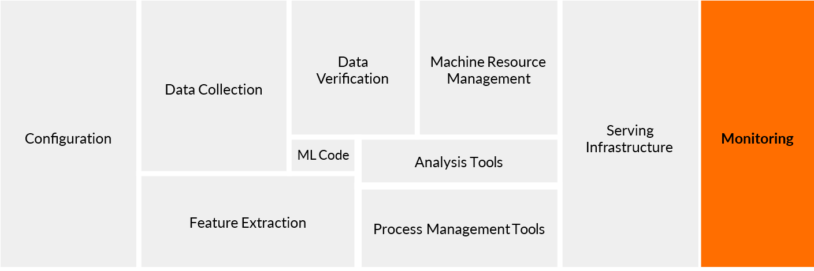
Why is ML monitoring different?

Slide 155
Model Monitoring
Observability in ML

Slide 156
What is observability?
Observability measures how well the internal states of a system can be inferred by knowing the inputs and outputs
Observability comes from control system theory
Observability and controllability are closely linked

Slide 157
Complexity of observing modern systems
Modern systems can make observability difﬁcult
Cloud-based systems
Containerized infrastructure
Distributed systems
Microservices

Slide 158
Deep observability for ML
Not only top-level metrics
Domain knowledge is important for observability
TensorFlow Model Analysis (TFMA)
Both supervised and unsupervised analysis

Slide 159
Goals of ML observability
Alertable
Metrics and thresholds designed to make failures obvious
Actionable
Root cause clearly identiﬁed

Slide 160
Model Monitoring
Monitoring Targets in ML

Slide 161
Basics: Input and output monitoring
Model input distribution
Model prediction distribution
Model versions
Input/prediction correlation

Slide 162
Input Monitoring
Errors: Input values fall within an allowed set/range?
Changes: Distributions align with what you’ve seen in the past?
Per slice, e.g., marital status (single/married/widowed/divorced)
Do these
check out?

Slide 163
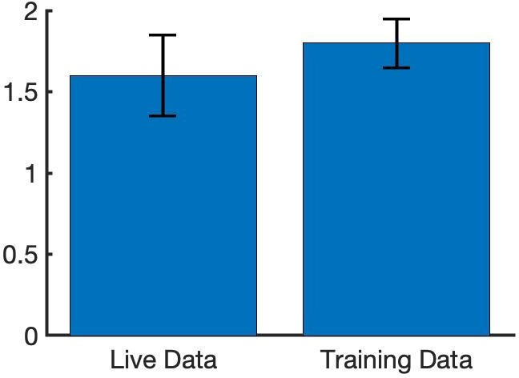
Prediction Monitoring
SEM
Statistical signiﬁcance
Unsupervised: Compare model prediction distributions
with statistical tests
e.g., median, mean, standard deviation, min/max values
Supervised: When labels are available

Slide 164
Operational Monitoring
ML engineering
Latency
IO / Memory / Disk Utilisation
System Reliability (Uptime) Auditability
Software engineering
Receiving an HTTP request Entering/leaving a function A user logging in
Reading from net / writing to disk

Slide 165
Model Monitoring
Logging for ML Monitoring

Slide 166
Steps for building observability
Start with the out-of-the-box logs, metrics and dashboards
Add agents to collect additional logs and metrics
Add logs-based metrics and alerting to create your own metrics and alerts
Use aggregated sinks and workspaces to centralize your logs and monitoring

Slide 167
Logging
Log: An event log (usually just called “logs”) is an immutable, time-stamped record of discrete events that happened over time.

Slide 168



Tools for building observability
Google Cloud Monitoring
Amazon CloudWatch
Azure Monitor
Google Cloud Monitoring

Slide 169

Logging - Advantages
Easy to generate
Great when it comes to providing valuable insight
Advantages
Focus on speciﬁc events

Slide 170

Logging - Disadvantages
Excessive logging can impact system performance
Aggregation operations on logs can be expensive (i.e., treat logs-based alerts with caution)
Disadvantages
Setting up & maintaining tooling carries with it a signiﬁcant operational cost

Slide 171
Logging in Machine Learning
Key areas
➔ Use logs to keep track of the model inputs and predictions
Input red ﬂags
➔ A feature becoming unavailable
➔ Notable shifts in the distributions
➔ Patterns speciﬁc to your model

Slide 172
Storing log data for analysis
Basic log storage is often unstructured
Parsing and storing log data in a queryable format enables analysis
Extracting values to generate distributions and statistics
Associating events with timestamps
Identifying the systems
Enables automated reporting, dashboards, and alerting

Slide 173
New Training Data
Prediction requests form new training datasets
For supervised learning, labels are required
Direct labeling
Manual labeling
Active learning
Weak supervision

Slide 174
Model Monitoring
Tracing for ML Systems

Slide 175


Distributed Tracing
Log
Monolithic System
Module
Module
Module
Module

Slide 176
Distributed Tracing
Service
Service
Log
Service
Service
Cloud

Slide 177


Tools for building observability
Sequencing and parallelism of service requests
Distributed tracing
Dapper
Zipkin
Jaeger

Slide 178
Model Monitoring
What is Model Decay?

Slide 179
Model Decay
Production ML models often operate in a dynamic environments
The ground truth in dynamic environments changes
If the model is static and does not change, then it gradually moves farther and farther away from the ground truth
Causes of Model Drift
Data Drift
Concept Drift

Slide 180
Data Drift (aka Feature Drift)
Increase in mean and variance
Statistical properties of input changes
Trained model is not relevant for changed data
For eg., distribution of demographic data like age might change over time
Age
Change in distribution of age feature

Slide 181
Concept Drift
Relationship between features and labels changes
The very meaning of what you are trying to predict changes
Prediction drift and label drift are similar
T₁ T₂ T₃
Change in relationship between the features and the labels

Slide 182

Detecting Drift on Time
Drift creeps into the system slowly with time
If it goes undetected, model accuracy suffers
Important to monitor and detect drift early

Slide 183
Model Monitoring
Model Decay Detection

Slide 184
Detecting Concept and Data Drift
Log Predictions (Full Requests and Responses)
Incoming prediction requests and generated prediction should be logged
If possible log the ground truth that should have been predicted
Can be used as labels for new training data
At a minimum log data in prediction request
This data is analysed to detect data drift that will cause model decay

Slide 185
Detecting Drift
Detected by observing the statistical properties of logged data, model predictions, and possibly ground truth
Deploy dashboards that plot statistical properties to observe how they change over time
Use specialized libraries for detecting drift
TensorFlow Data Validation (TFDV)
Scikit-multiﬂow library

Slide 186
Model Monitoring
Ways to Mitigate Model Decay

Slide 187
Mitigating Model Decay
When you’ve detected model decay:
At the minimum operational and business stakeholders should be notiﬁed of the decay
Take steps to bring model back to acceptable performance

Slide 188
Steps in Mitigating Model Decay
What if Drift is Detected?
If possible, determine the portion of your training set that is still correct
Keep the good data, discard the bad, and add new data - OR -
Discard data collected before a certain date and add new data - OR -
Create an entirely new training dataset from new data

Slide 189
Fine Tune, or Start Over?
You can either continue training your model, ﬁne tuning from the last checkpoint using new data - OR -
Start over, reinitialize your model, and completely retrain it
Either approach is valid, so it really depends on results
How much new labelled data do you have?
How far has it drifted?
Try both and compare

Slide 190
Model Re-Training Policy
On-Demand
Manually re-train the model
On a Schedule
New labelled data is available at a daily, weekly or monthly basis
Availability of New Training Data
New data available on ad-hoc basis, when it is collected and available in source database

Slide 191
Automating Model Retraining
Model Performance Degradation
Manually retrain the model
Data Drift
When you notice signiﬁcant changes in the data

Slide 192
Redesign Data Processing Steps and Model Architecture
When model performance decays beyond an acceptable threshold you might have to consider redesigning your entire pipeline
Re-think feature engineering, feature selection
You may have to train your model from scratch
Investigate on alternative architectures

Slide 193
Model Monitoring
Responsible AI

Slide 194
Responsible AI Practices
Development of AI creates new opportunities to improve the lives of people around the world
Business, healthcare, education, etc.
But it also raises new questions about implementing responsible practices
Fairness, interpretability, privacy, and security
Far from solved, active areas of research and development

Slide 195
Human-Centered Design
Actual users’ experience is essential
Design your features with appropriate disclosures built-in
Consider augmentation and assistance
Offering multiple suggestions instead of one right answer
Model potential adverse feedback early in the design process
Engage with a diverse set of users and use-case scenarios

Slide 196
Identify Multiple Metrics
Using several metrics helps you understand the tradeoffs
Feedback from user surveys
Quantities that track overall system performance
False positive and false negative sliced across subgroups
Metrics must be appropriate for the context and goals of your system

Slide 197
Analyze your raw data carefully
For sensitive raw data, respect privacy
Compute aggregate, anonymized summaries
Does your data reﬂect your users?
Example: will be used for all ages, but all data from senior citizens
Imperfect proxy labels?
Relationship between the labels and actual targets
Using label X as a proxy for target Y - any problematic gaps?

